Slide 1

PYCAMP 2.0
Day 3
(File Handling IN PYTHON)

Slide 2

Agenda for Day 3
1
Exception Handling
2
File Handling

Slide 3
Exception Handling
Python has many built-in exceptions that are raised when your program encounters an error
When these exceptions occur, the Python interpreter stops the current process and passes it to the calling process until it is handled. If not handled, the program will crash.
To avoid crashing of our program we use try and except to handle the error messages
Try : The try block is used to check some code for errors i.e the code inside the try block will execute when there is no error in the program.
Except : Whereas the code inside the except block will execute whenever the program encounters some error in the preceding try block.
However, a set itself is mutable. We can add or remove items from it.

Slide 4

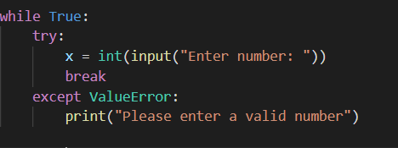
Exception Handling (Errors)
The common errors to catch
ZeroDivisionError (no divided by 0)
ValueError (wrong value used)
TypeError (eg : str + int)
IndexError (for sets)
IOError (input/output fails)
Error Found

Slide 5
File Handling
Working with file programmatically using python
Create Files
Read Files
Update FIle
Delete FIle

